Slide 1



SPOT THE SHAM
Fake product review monitoring using Machine Learning
TEAM DETAILS:
VEMIREDDY TEJASWINI : 22N31A05R1
TONTA NIHARIKA : 22N31A05P8
SATYA BHARAT : 22N31A05M2

Slide 2

SPOT THE SHAM
Fake product review monitoring using Machine Learning
TEAM DETAILS:
VEMIREDDY TEJASWINI : 22N31A05R1
TONTA NIHARIKA : 22N31A05P8
SATYA BHARAT : 22N31A05M2
Guide name: MS.V. SHILPA

Slide 3



INTRODUCTION
Monitoring fake product reviews is vital in e-commerce to prevent manipulation of ratings. Machine learning algorithms analyze patterns to identify and filter out fake reviews. This ensures that customers get accurate information and that businesses compete fairly.

Slide 4
ABSTRACT
The "Fake Product Review Monitoring" system tackles the challenge of fake reviews in online shopping by employing machine learning techniques. It uses sentiment analysis and IP address tracking to spot and flag suspicious activity, such as multiple positive reviews from the same IP. By identifying these patterns, the system effectively filters out deceptive reviews. This ensures that only authentic feedback influences consumer decisions. As a result, users receive accurate and reliable information, enhancing their shopping experience.

Slide 5



PURPOSE
Ensure Honest Customer Feedback
(1)
Improve Consumer Trust
(2)
Support Fair Competition
(3)

Slide 6



OBJECTIVES
Detect fake reviews
Sentimental and behavioral analysis
Model Evaluation and Improvement

Slide 7





sOFTWARE REQUIREMENTS
Hardware requirements
SCOPE
Sentiment Analysis
IP Address Tracking
Machine Learning Models
Utilizing algorithms to analyze review content and detect inconsistencies that may indicate fake reviews.
Monitoring IP addresses to identify patterns, such as multiple reviews from the same source, which may signal fraudulent activity.
Developing models to accurately distinguish between genuine and fake reviews, enhancing the system's ability to filter out deceptive feedback.

Slide 8





REQUIREMENTS
Accuracy
Limited Accuracy due to high false positive or false negative rates
SOFTWARE REQUIREMENTS
HARDWARE REQUIREMENTS
CONTEXT
Many current systems may not understand the context of reviews or nuances in review language
Operating System: Windows 11
Front End: HTML, CSS, JS
Back End: Python
Database: MySQL
Processor: Intel Core i3-4200U
CPU: 1.6GHz
RAM: 4 GB
Hard Disk: 500 GB
scalability
Failed to handle large volumes of data leading to slower processing

Slide 9

DRAWBACKS
Accuracy
Limited Accuracy due to high false positive or false negative rates
CONTEXT
EXISTING
SYSTEM
Many current systems may not understand the context of reviews or nuances in review language
scalability
Failed to handle large volumes of data leading to slower processing

Slide 10





PROPOSED SYSTEM
Advanced Machine Learning Integration
Real-Time Anomaly Detection and Adaptive Learning
Explainable AI and Continuous Improvement

Slide 11


LITERATURE SURVEY
The paper "Fake Reviews Detection using Supervised Machine Learning" by Ahmed M. Elmogy et al. (2021) uses a hybrid RNN with attention to detect fake reviews from a dataset of 15,000 tweets.
The model, implemented in Python and Keras, showed strong accuracy and performance. This research supports our project's methods and provides benchmarks for evaluation.

Slide 12



USER MODULE
ACTION
ROLE
Submits reviews after purchasing a product, logs into the system, and views the products.
Provides feedback in the form of reviews, which could be genuine or fake.

Slide 13
SYSTEM MODULE
ACTION
ROLE
Collects, processes, and analyzes the reviews submitted by customers. Uses machine learning algorithms to classify reviews as fake or genuine.
Performs the core functionality of detecting fake reviews based on predefined models and features.

Slide 14
ADMIN MODULE
ACTION
ROLE
Manages the system by reviewing flagged reviews, approving or rejecting them, and monitoring system performance.
Ensures that the detection system works correctly, handling any false positives or negatives and maintaining the quality of reviews.

Slide 15

EXPLORING
ARCHITECTURE AND DESIGN

Slide 16
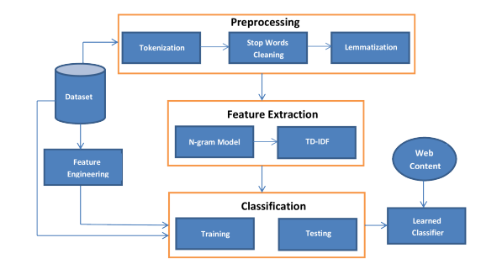

Slide 17

DATASET
In the design of the Fake Product Review Detection System using Machine Learning, the dataset is sourced from platforms like Kaggle or Amazon, containing product reviews with features such as review text, ratings, user IDs, product IDs, and timestamps. The dataset is balanced between real and fake reviews, and a small portion of sample data is examined to understand its structure

Slide 18

DATA PREPROCESSING
In the preprocessing stage, raw reviews are cleaned by removing special characters, stop words, URLs, and numbers. The text is then tokenized into words and normalized by converting it to lowercase. Missing data is addressed through imputation or removal, and data augmentation techniques may be applied to generate synthetic data for balance.

Slide 19

FEATURE EXTRACTION
Feature extraction is crucial for preparing text for machine learning. Techniques like TF-IDF measure word relevance, while word embeddings such as Word2Vec or GloVe convert words into vector representations. Sentiment analysis assigns sentiment scores to reviews, and additional features like review length and metadata (submission time, user activity) enhance model performance. IP address tracking may also be used to monitor suspicious behavior.

Slide 20

CLASSIFICATION
In the classification stage, machine learning models like Logistic Regression, Support Vector Machines (SVM), and Random Forest are used to classify reviews as fake or real. Deep learning models such as Recurrent Neural Networks (RNN) and Long Short-Term Memory (LSTM) are employed for capturing sequential dependencies in the text. The dataset is split into training and testing sets (e.g., 70-30 split), with the model trained on the training data and evaluated on the testing data using metrics like accuracy, precision, recall, and F1-score.

Slide 21



UML DIAGRAMS

Slide 22
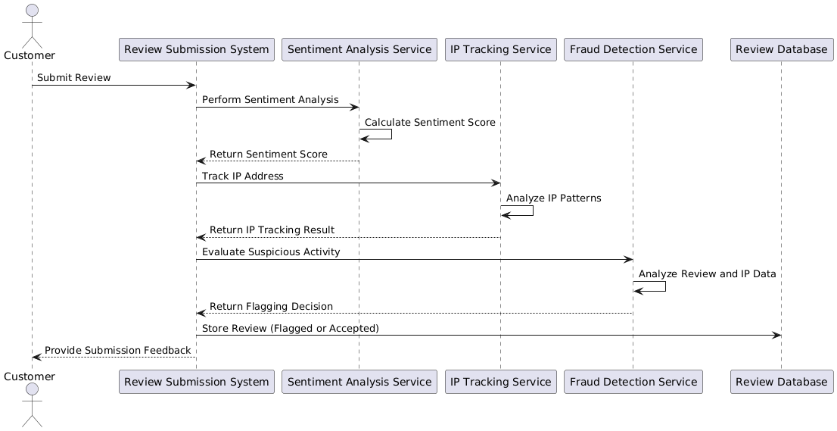
SEQUENCE DIAGRAM

Slide 23
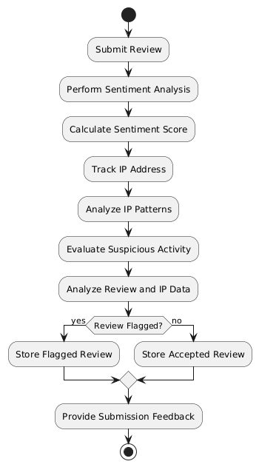
ACTIVITY
DIAGRAM

Slide 24
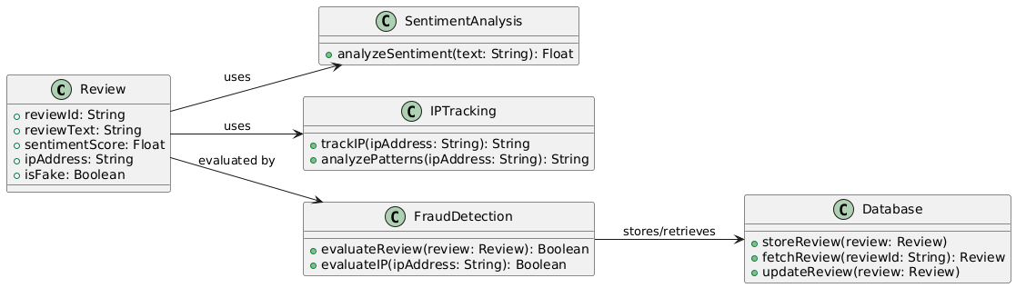
CLASS DIAGRAM

Slide 25
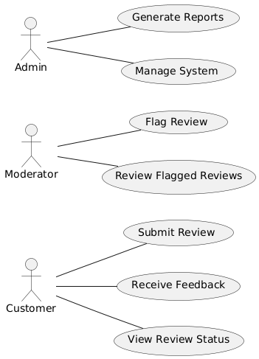
USE CASE
DIAGRAM

Slide 26
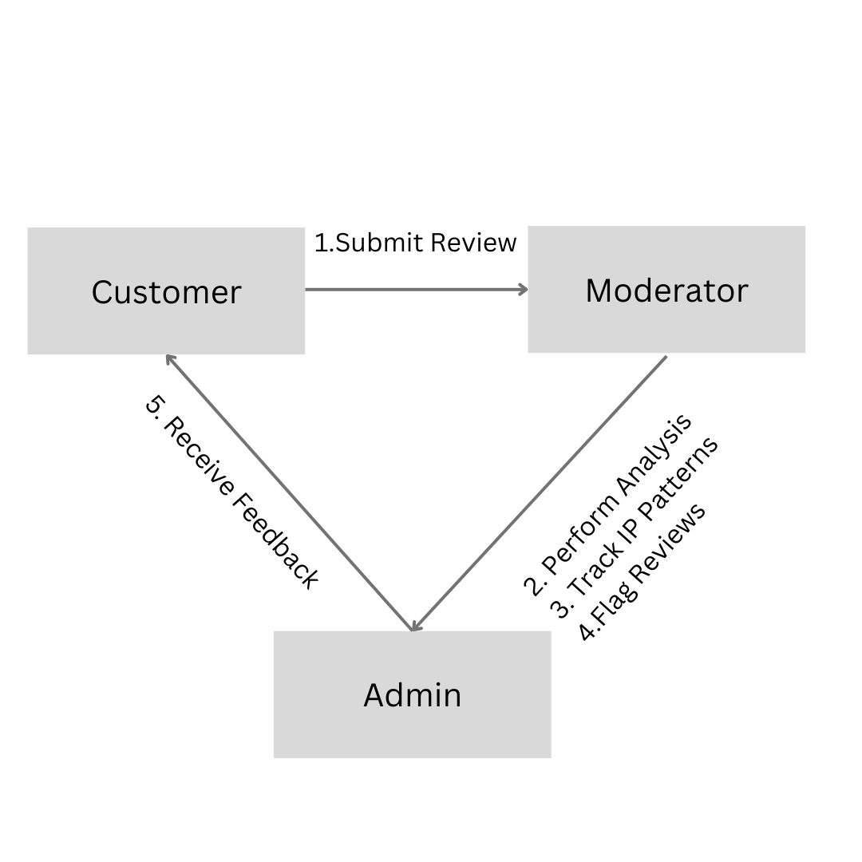
COLLABORATION
DIAGRAM

Slide 27
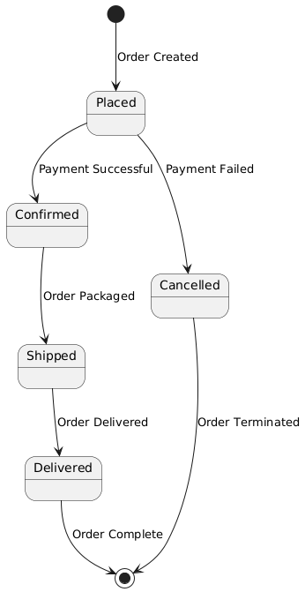
STATE CHART
DIAGRAM

Slide 28
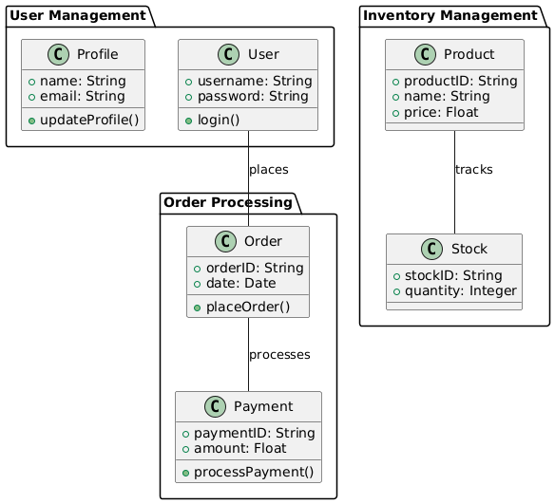
PACKAGE
DIAGRAM

Slide 29
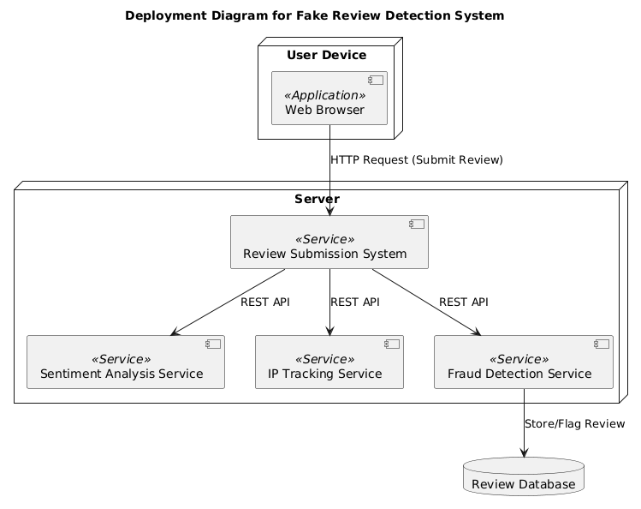
DEPLOYMENT
DIAGRAM

Slide 30



THANK YOU!

